Slide 1
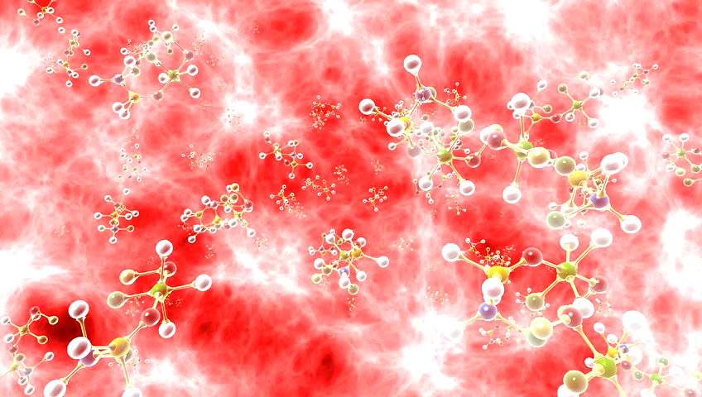
Clinical Decision Support System
for Covid-19
Detection and Visualisation Project
Guide:
Prof.Shola Usha Rani
Submitted By:
G.Pavan Kumar
16MIS1097

Slide 2
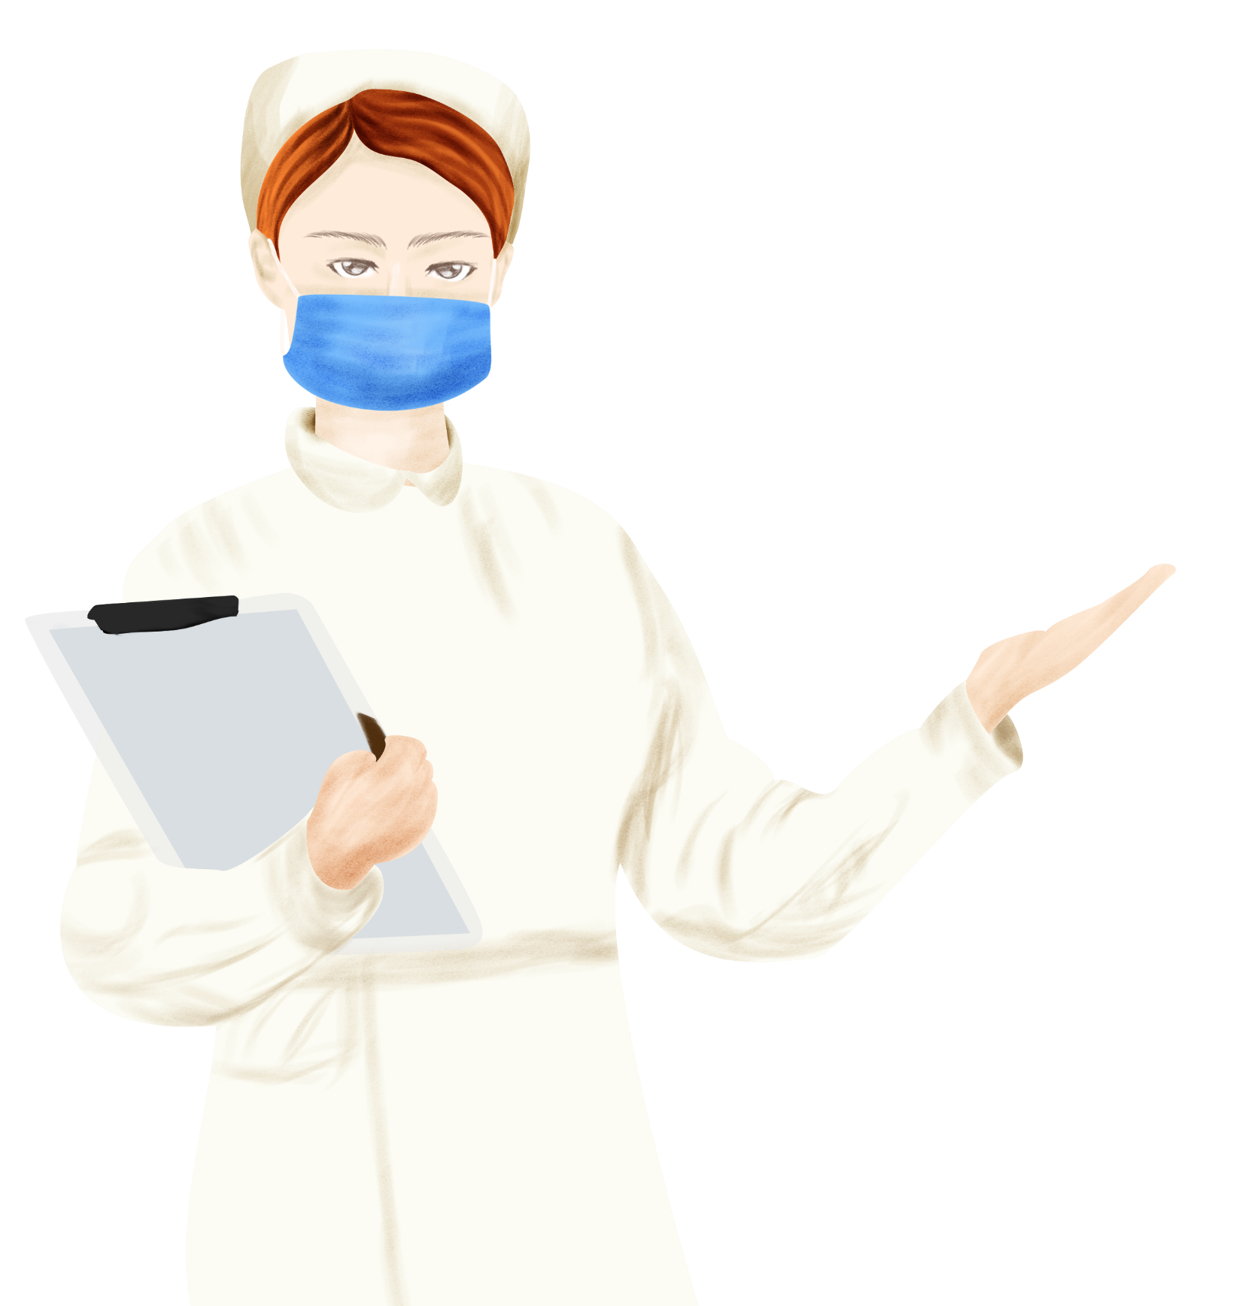
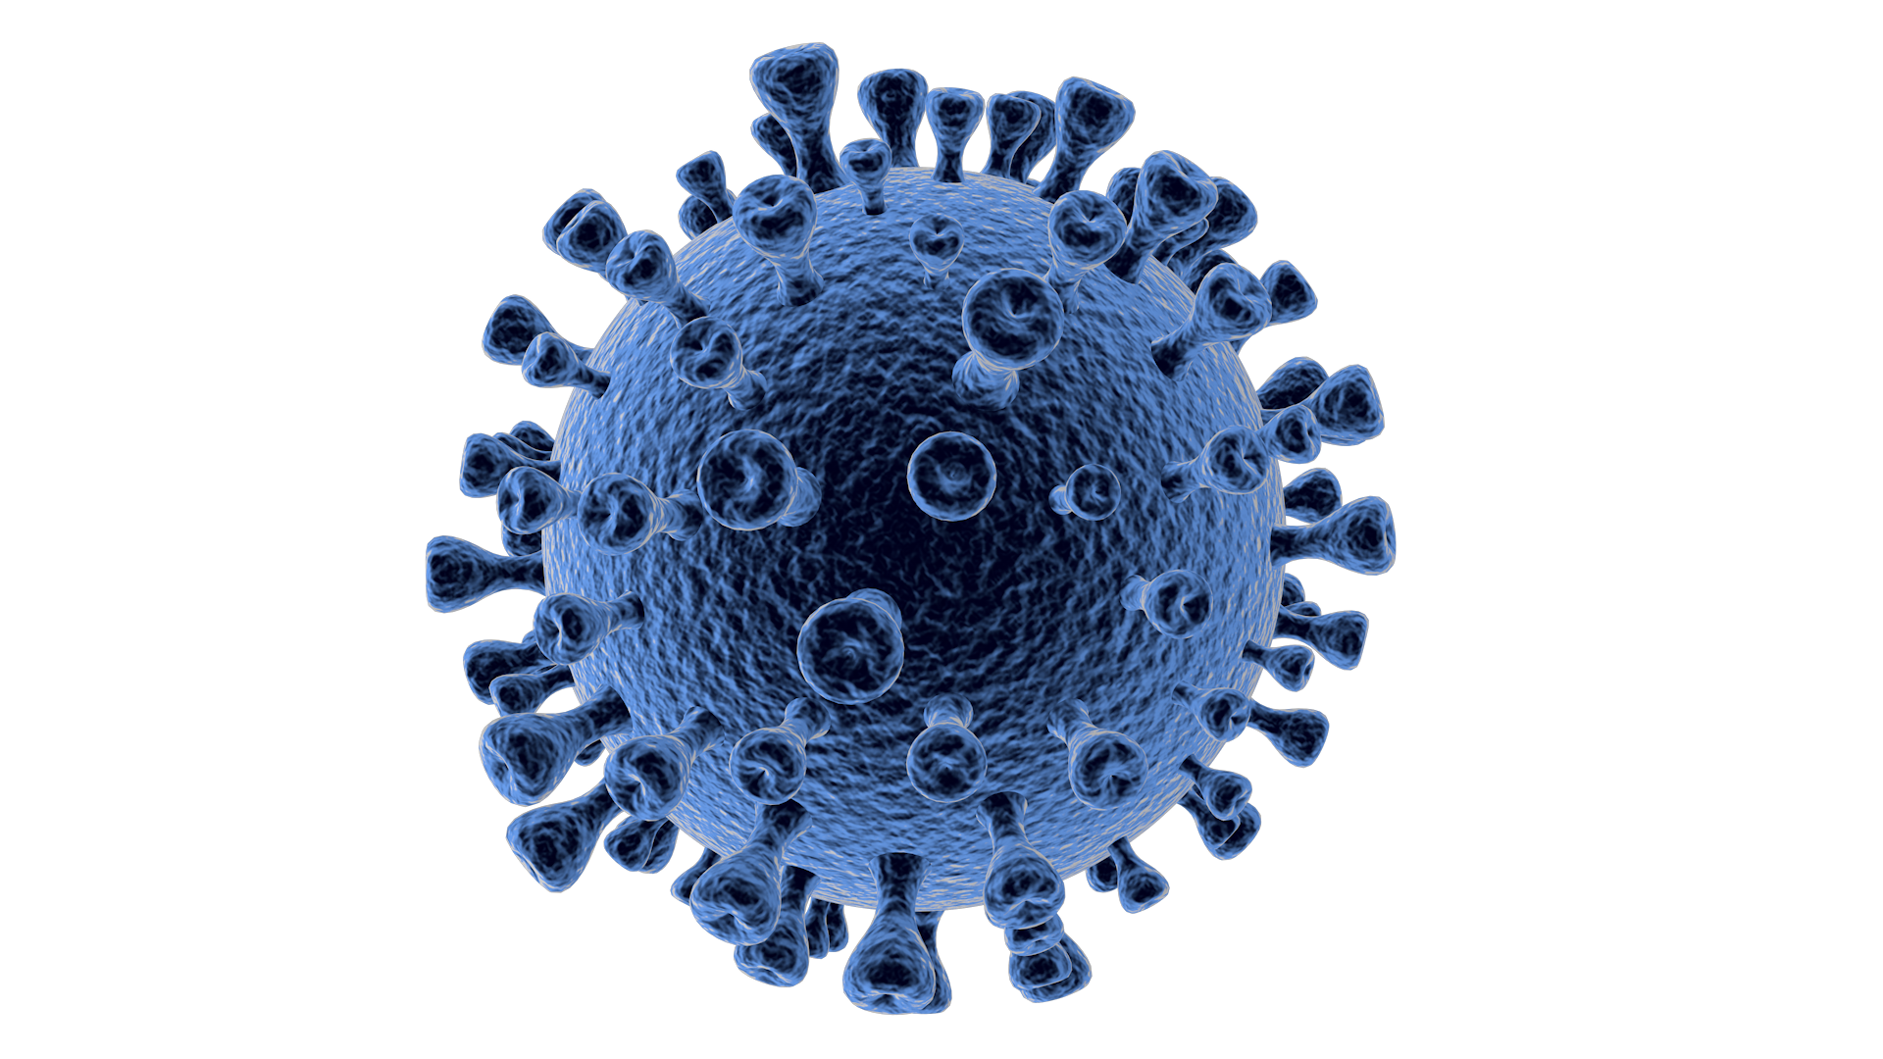

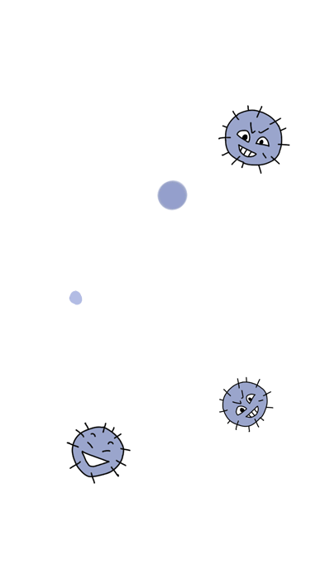
2019-nCoV Prevention Manual
What is the new coronavirus
What is the new coronavirus
Coronavirus is a general term for a very common type of virus that exists widely in nature. 2019-nCoV from Wuhan is a new type of coronavirus that mainly causes infection of the respiratory system. On January 20th, the National Health and Health Commission included pneumonia infected with the new coronavirus as a Class B infectious disease and managed it as a Class A; at the same time, it included the quarantine infectious disease stipulated in the "People's Republic of China's Frontier Health and Quarantine Law".

Slide 3

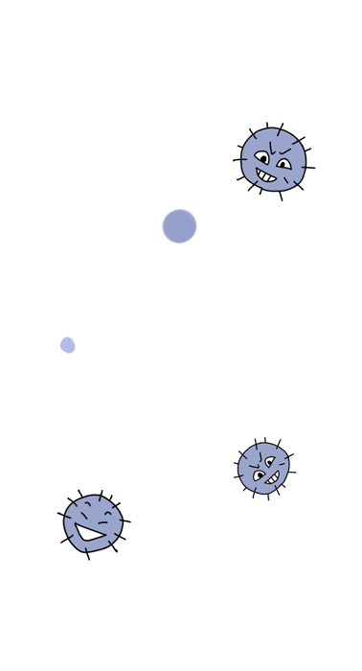

2019-nCoV Prevention Manual
What is the new coronavirus
Main symptoms: fever (≥37.3 ℃), fatigue, dry cough

Slide 4
2019-nCoV Prevention Manual
Problem Statement:
The Coronavirus has Devestated the World today and Doctors are scarce as does the Diagnosis. All the medical professional around the world are in a Desperate Need for Intellegent Machine that will be Efficient, Accurate, Fast Decison Making & that could Visually able to identify the Opacity.

Slide 5
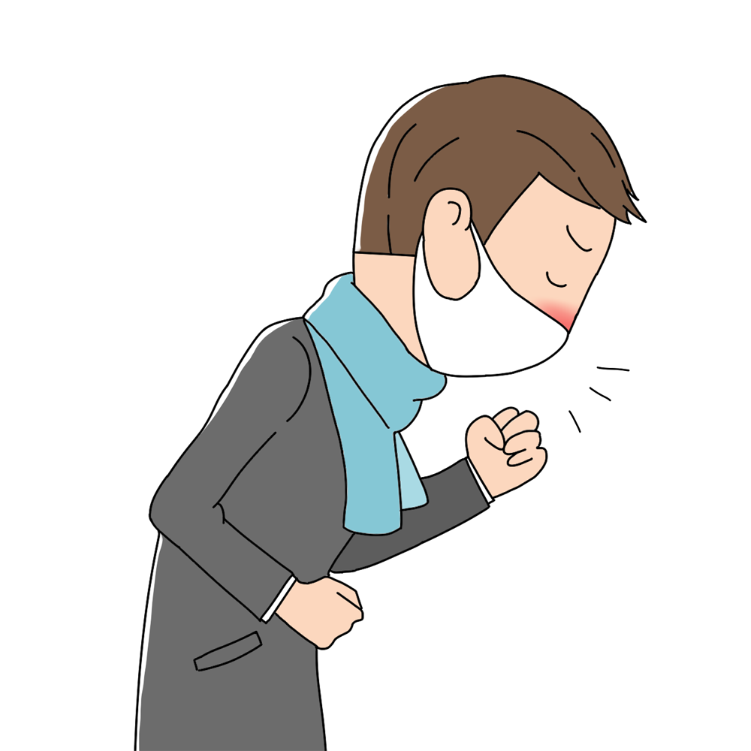
Objectives:
Graduated study on the Network.
Implement most efficient Algorithm(Neural Network).
previously a simple CNN was implemented which is not
efficient as “Alexnet” which is a densly connected neural network.
Aggregation of the high-grade DataSet.
Achieve Optimum accuracy.

Slide 6
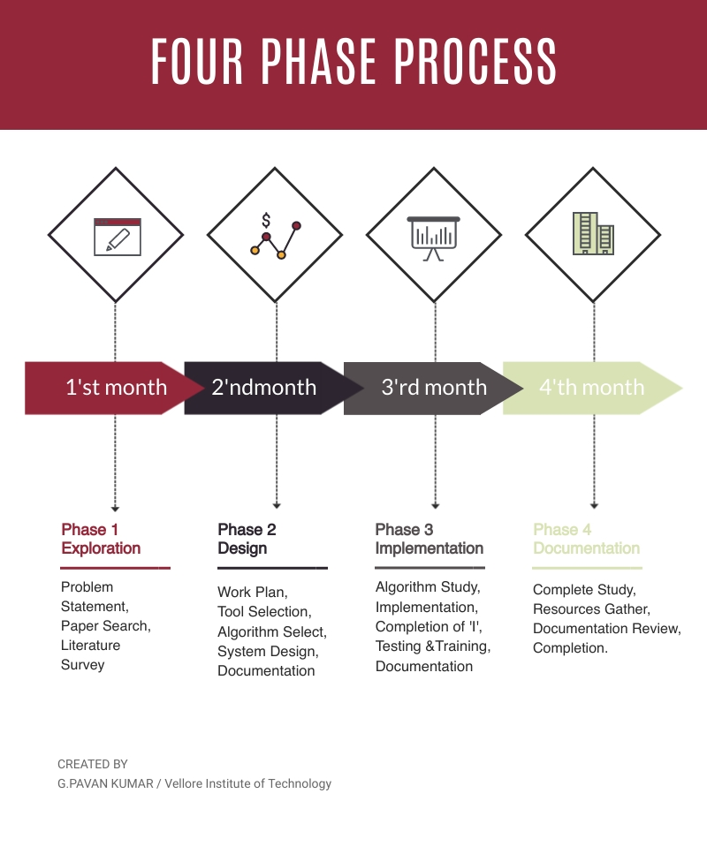
System Planning:
Clinical Decision making aims to develop a Dense CNN to predict whether the input image is having COVID-19 so for this high-grade data sets, desired set of knowledge need to be obtained and it will be achieved in sequential steps.

Slide 7
Phase-1:Exploration
Aims to identify problem and perform a deep search for literature survey and research paper.
Phase-2: Design
In this phase the objectives are identified based on that a work plan is designed and based on the research paper we have to identify a efficient algorithm and document the results above
Phase-3&4: Implementation
A regressive and professional algorithmic study need to be performed so that to implement a better algorithm later stages includes training and testing and completion the complete documentation.

Slide 8
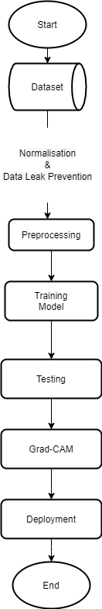
Data Flow Diagram

Slide 9
AlexNet
This architecture was one of the first deep networks to push ImageNet Classification accuracy by a significant stride in comparison to traditional methodologies. It is composed of 5 convolutional layers followed by 3 fully connected layers
It’s name came from one of the proficient authors- AlexKrizhevsky and it is one of the prime deep convolutional neural networks developed in 2012.AlexNet has a similar structure to that of DenseNet,but uses more convolutional layers and a larger parameter space to fit the large-scale ImageNet dataset.

Slide 10
Advantages:
It is the first major CNN model that used GPU’s to train and this lead to faster training.
It is a Deep Architecture with a total of 8 layers and this means efficient ability to extract features and it also works well with RGB images.
It allows us to negate the negative outputs of summation of gradients and data and this means its speed increases much faster.
Alex-Net uses “RELU” activation which means there wont be much loss of features.“RELU”does’nt limit the output features which means not only dominant but also mild features are gained.
Disadvantages:
➢Requires GPU for longer periods to train.

Slide 11
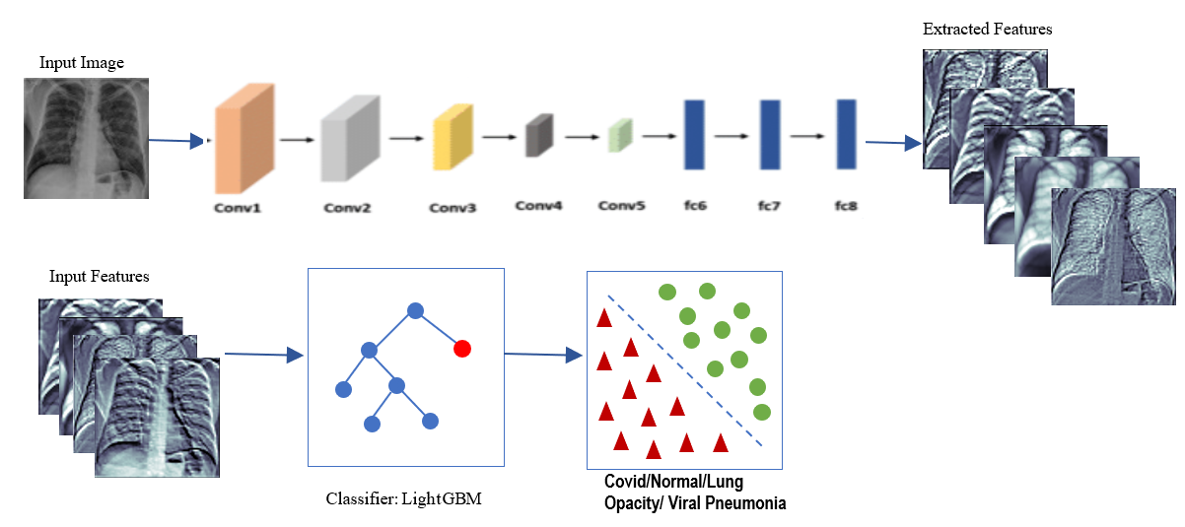
Model Design

Slide 12
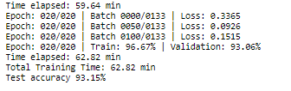
2019-nCoV Prevention Manual
Implementation Results:
Training:
Achieved: 96.8% Accuracy.
Test:
Achieved: 93.15% Accuracy.

Slide 13
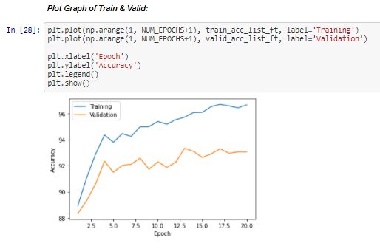
Training Model Graph:

Slide 14
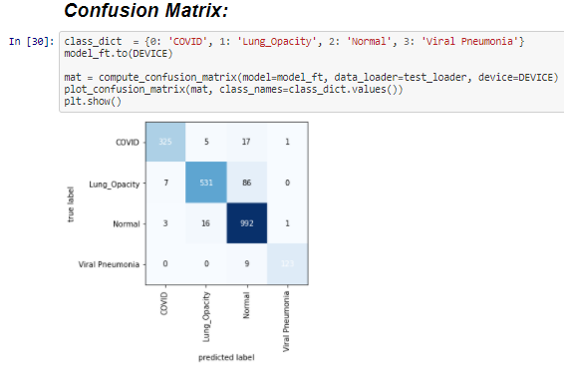

Slide 15
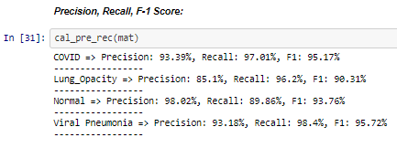

Slide 16
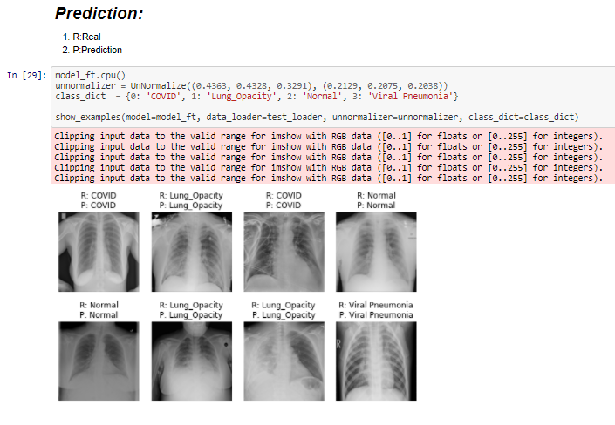

Slide 17
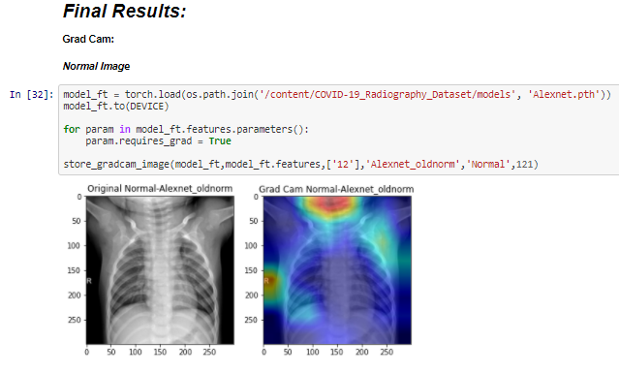

Slide 18
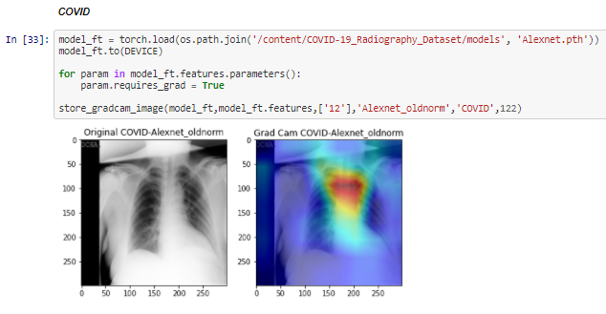

Slide 19
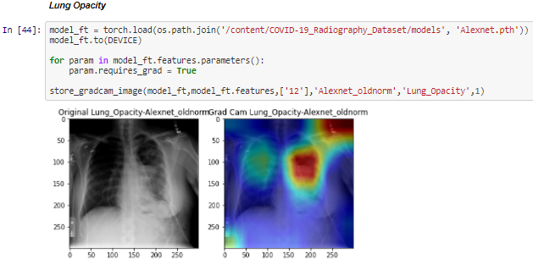

Slide 20
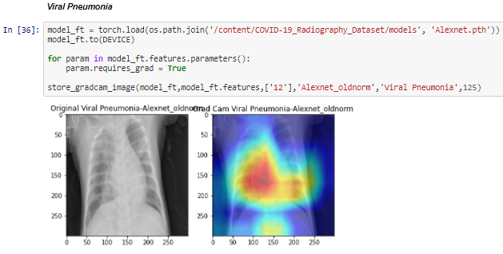

Slide 21
Conclusion & Future Work:
The proposed system works ‘Efficiently and Accurately’ in detecting the presence of not just covid-19 but also some other abnormalities in the chest x-ray image and provides a way to visualize them using grad-cam technique and future work includes re-implementation using updated images and deployment of an application that allows medical personnel to use the system.

Slide 22
Everyone Is Responsible
For Fighting The Epidemic
Thank You

